Slide 1

Can we use a for
loop from yesterday to print numbers 1 to 5 ?

Slide 2
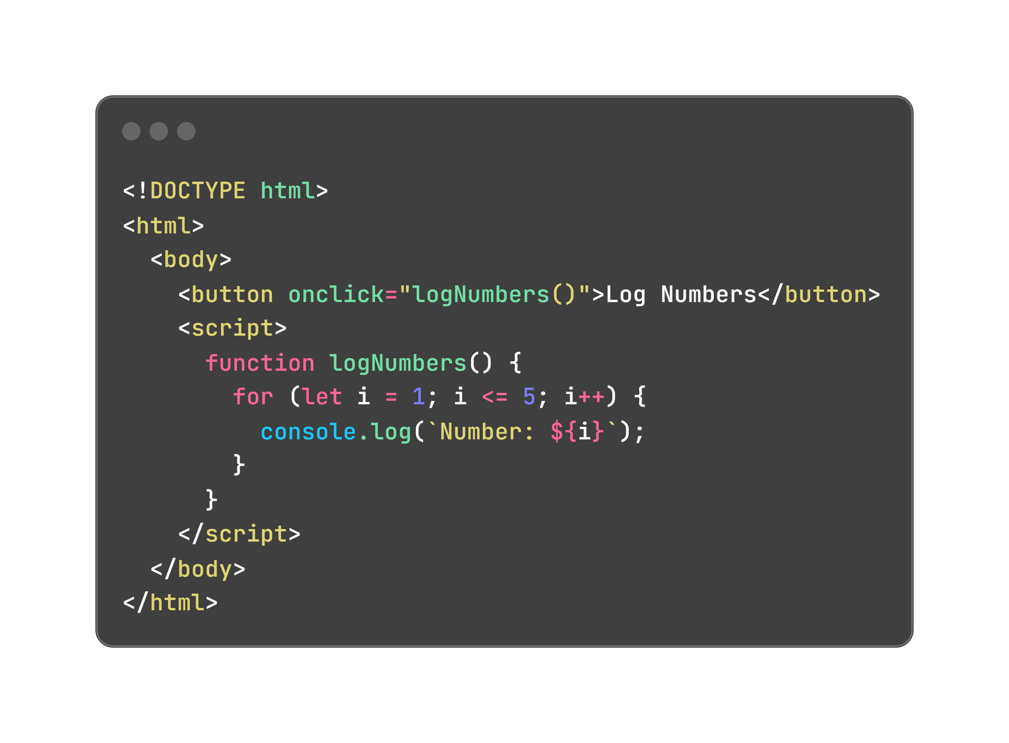
Can we use a for
loop from yesterday to print numbers 1 to 5 ?

Slide 3
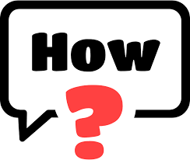
How It Works
The for loop repeats 5 times, printing each number. This reviews loops from Day 4.
Loops are great for repeating tasks! Today, we’ll store lists of things in arrays and use loops to work with them!

Slide 4
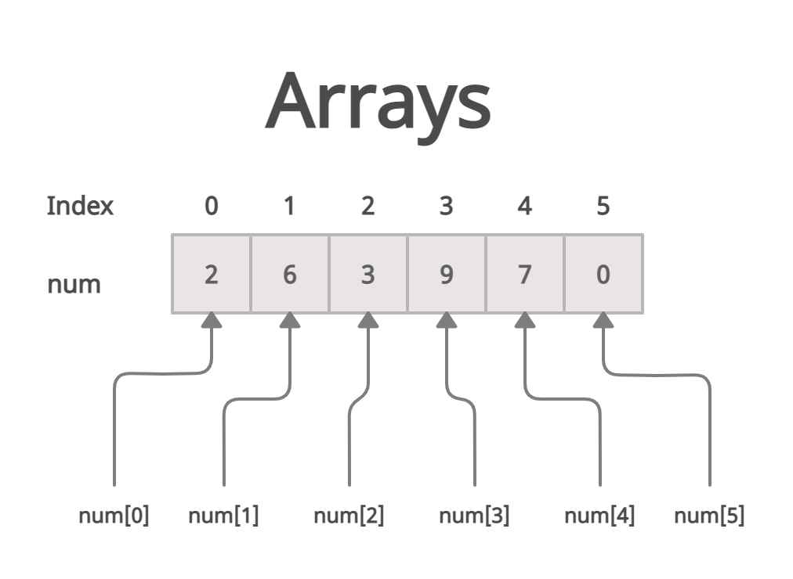
What’s an Array?
A list of items, like a shopping list or a playlist.
Each item has a number (index) starting at 0.
Example: ["apple", "banana", "orange"] apple is at index 0, banana at 1, orange at 2.

Slide 5
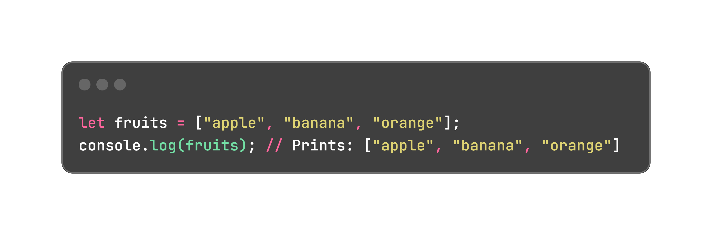
How to Create an Array:
Use square brackets []

Slide 6
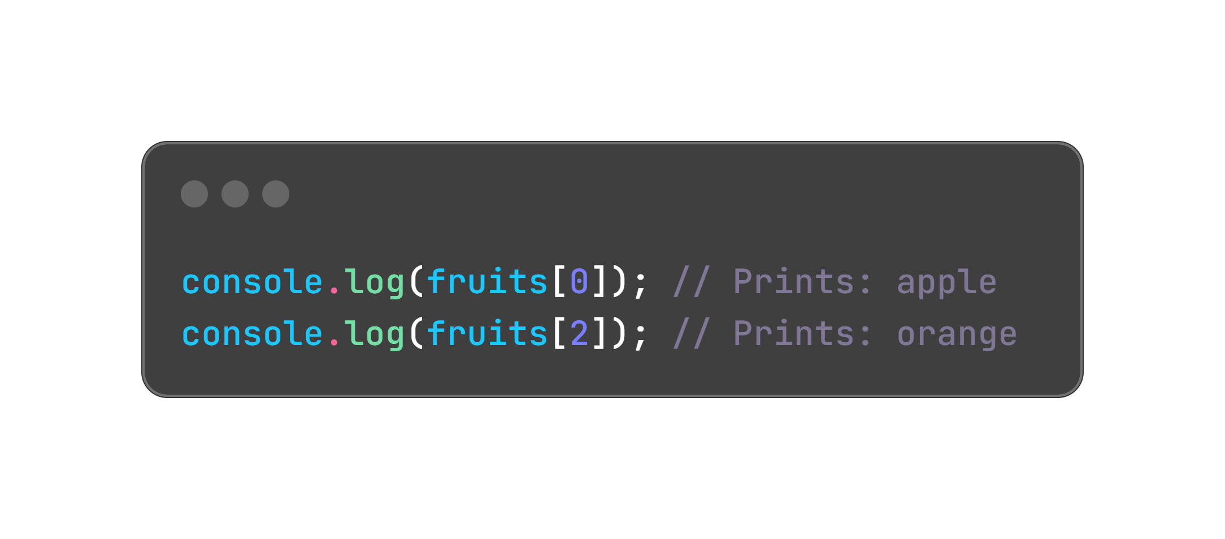
Accessing Items (Indexing):

Slide 7
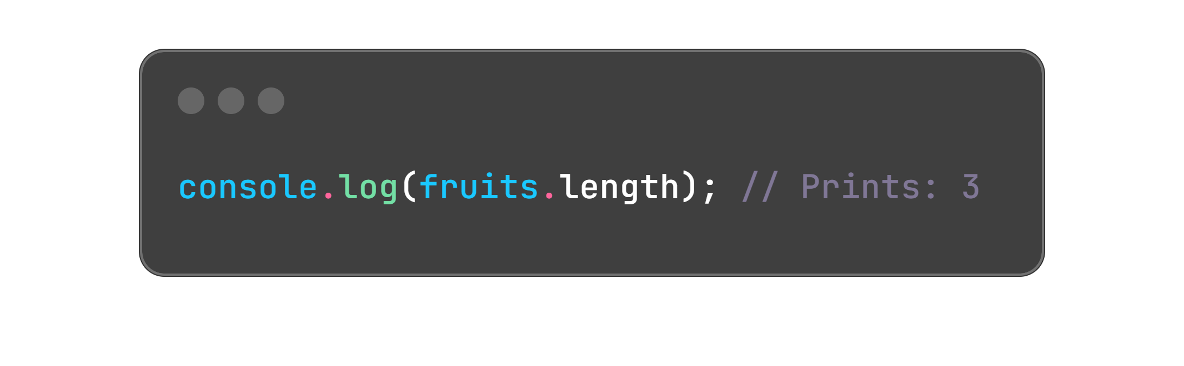
Array Length:
The number of items in the array:

Slide 8
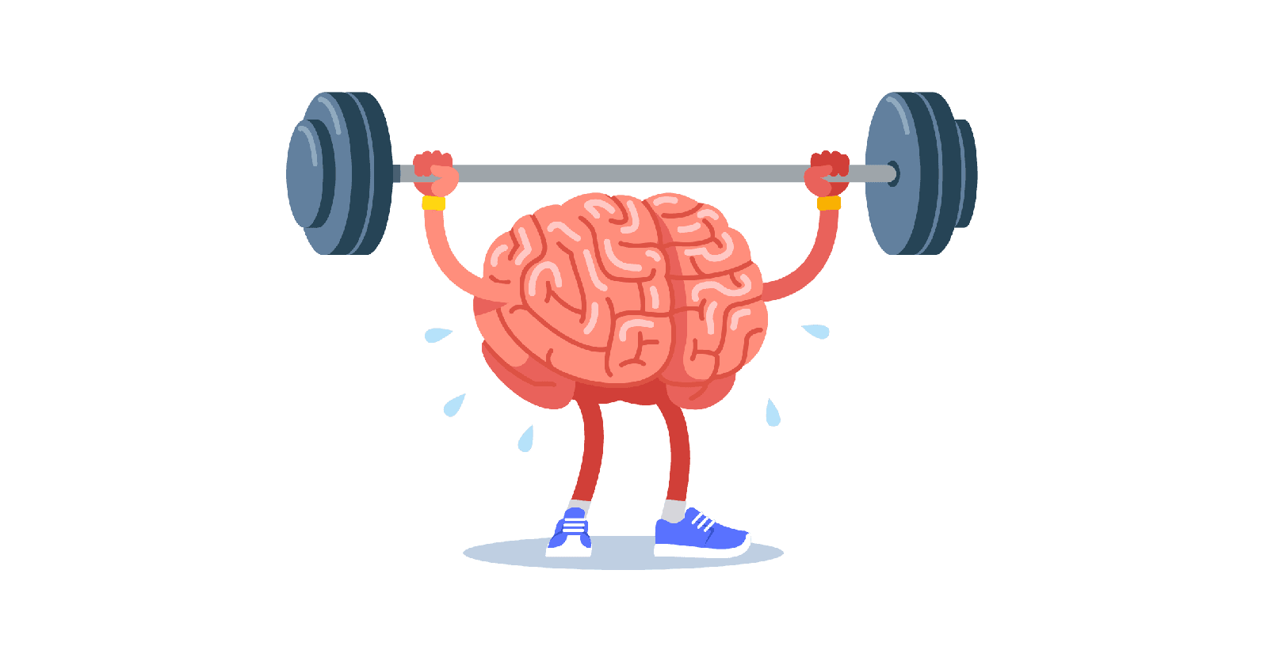
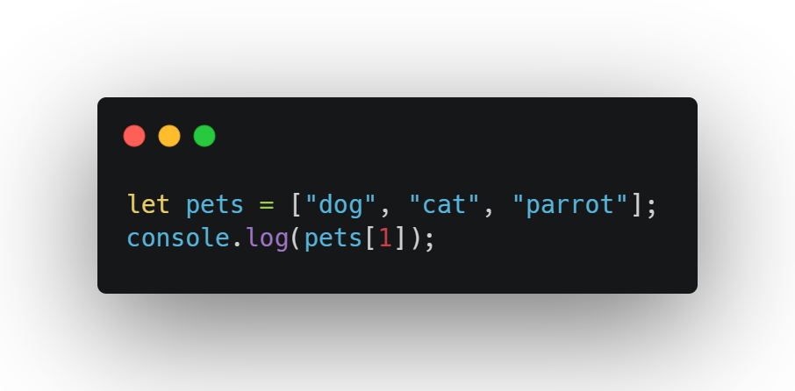
Question 1:

Slide 9
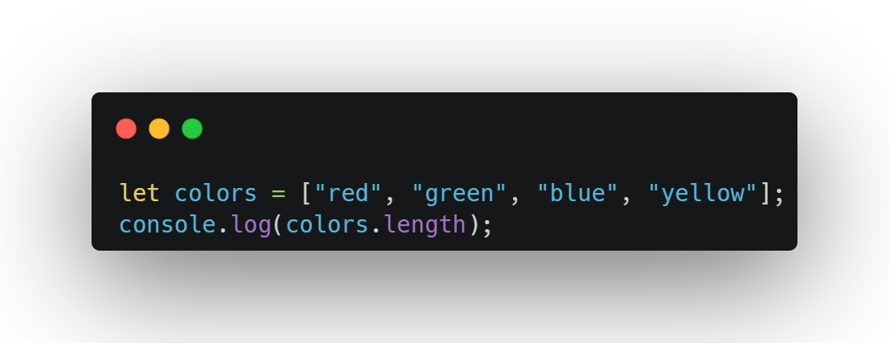
Question 2:

Slide 10
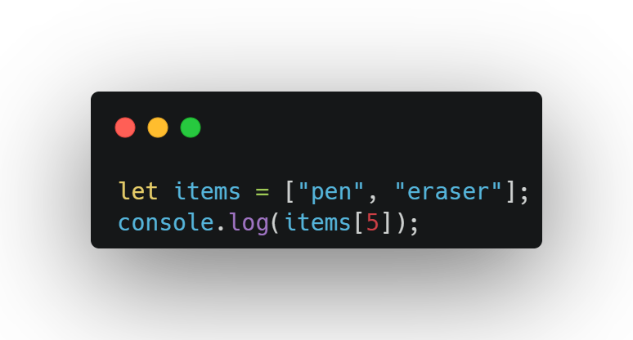
Question 3:

Slide 11
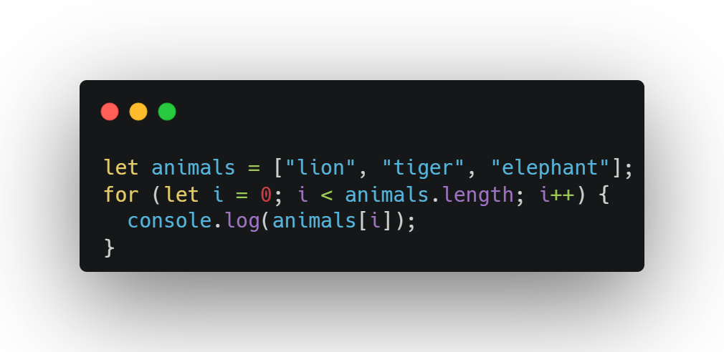
Question 4:

Slide 12
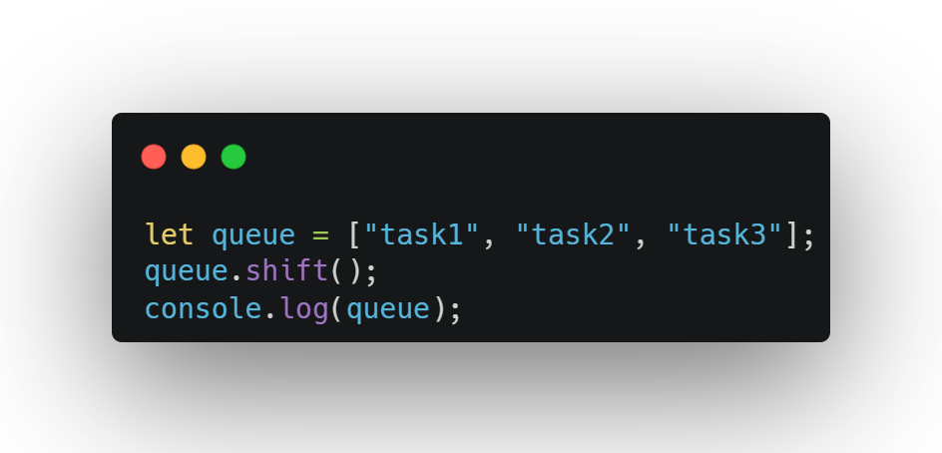
Question 5:

Slide 13
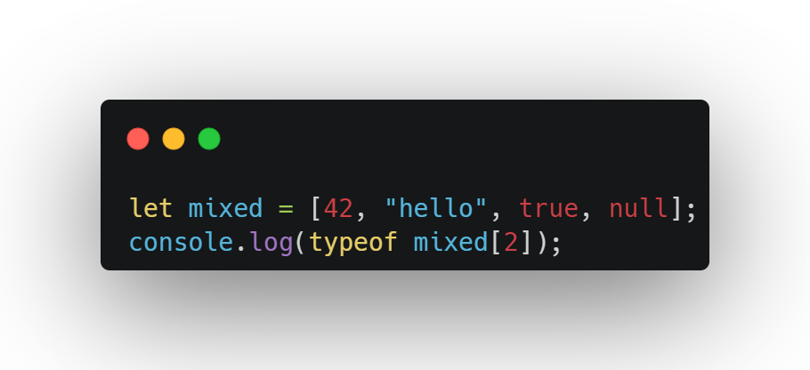
Question 6:

Slide 14
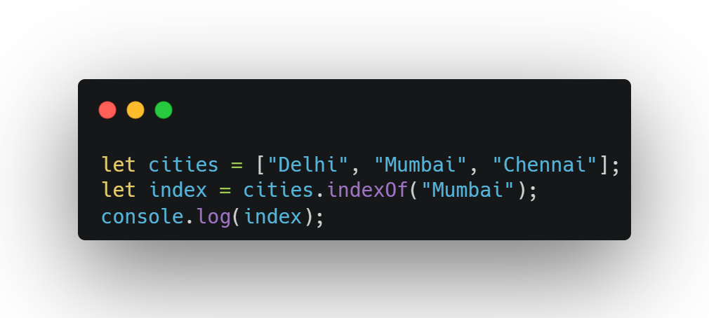
Question 7:

Slide 15
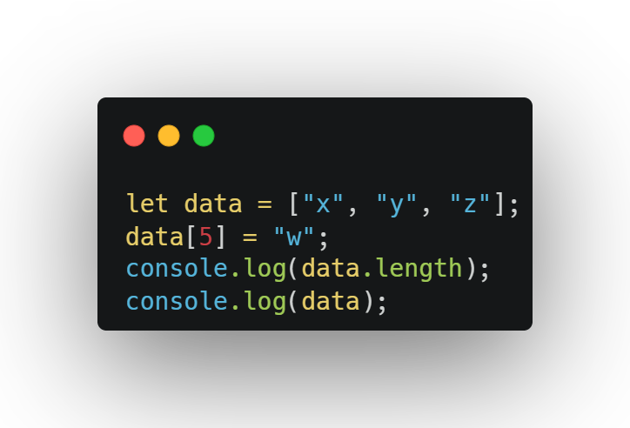
Question 8:

Slide 16
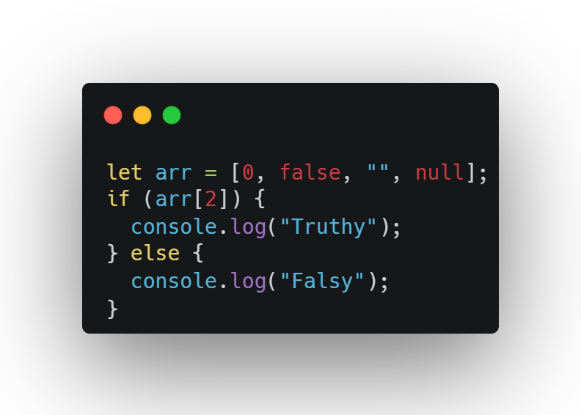
Question 9:

Slide 17
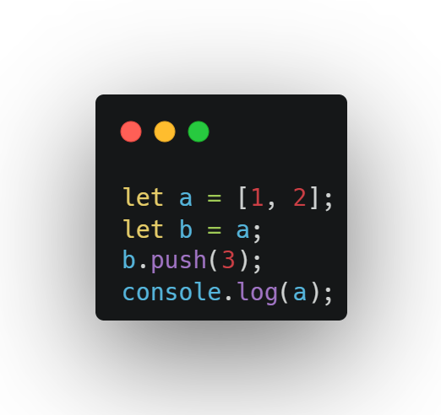
Question 10:

Slide 18

Why Use Arrays?
Store lists like groceries, scores, or names.
Loop through items to show or change them.
Keep things organized in one place.

Slide 19

Tips:
Index starts at 0, not 1.
Don’t try to access an index that doesn’t exist (like fruits[3]—it’s undefined).

Slide 20
Mutating Arrays
Arrays can change: add, remove, or update items.
Common methods:
push: Add to the end.
pop: Remove from the end.
shift: Remove from the start.
unshift: Add to the start.

Slide 21
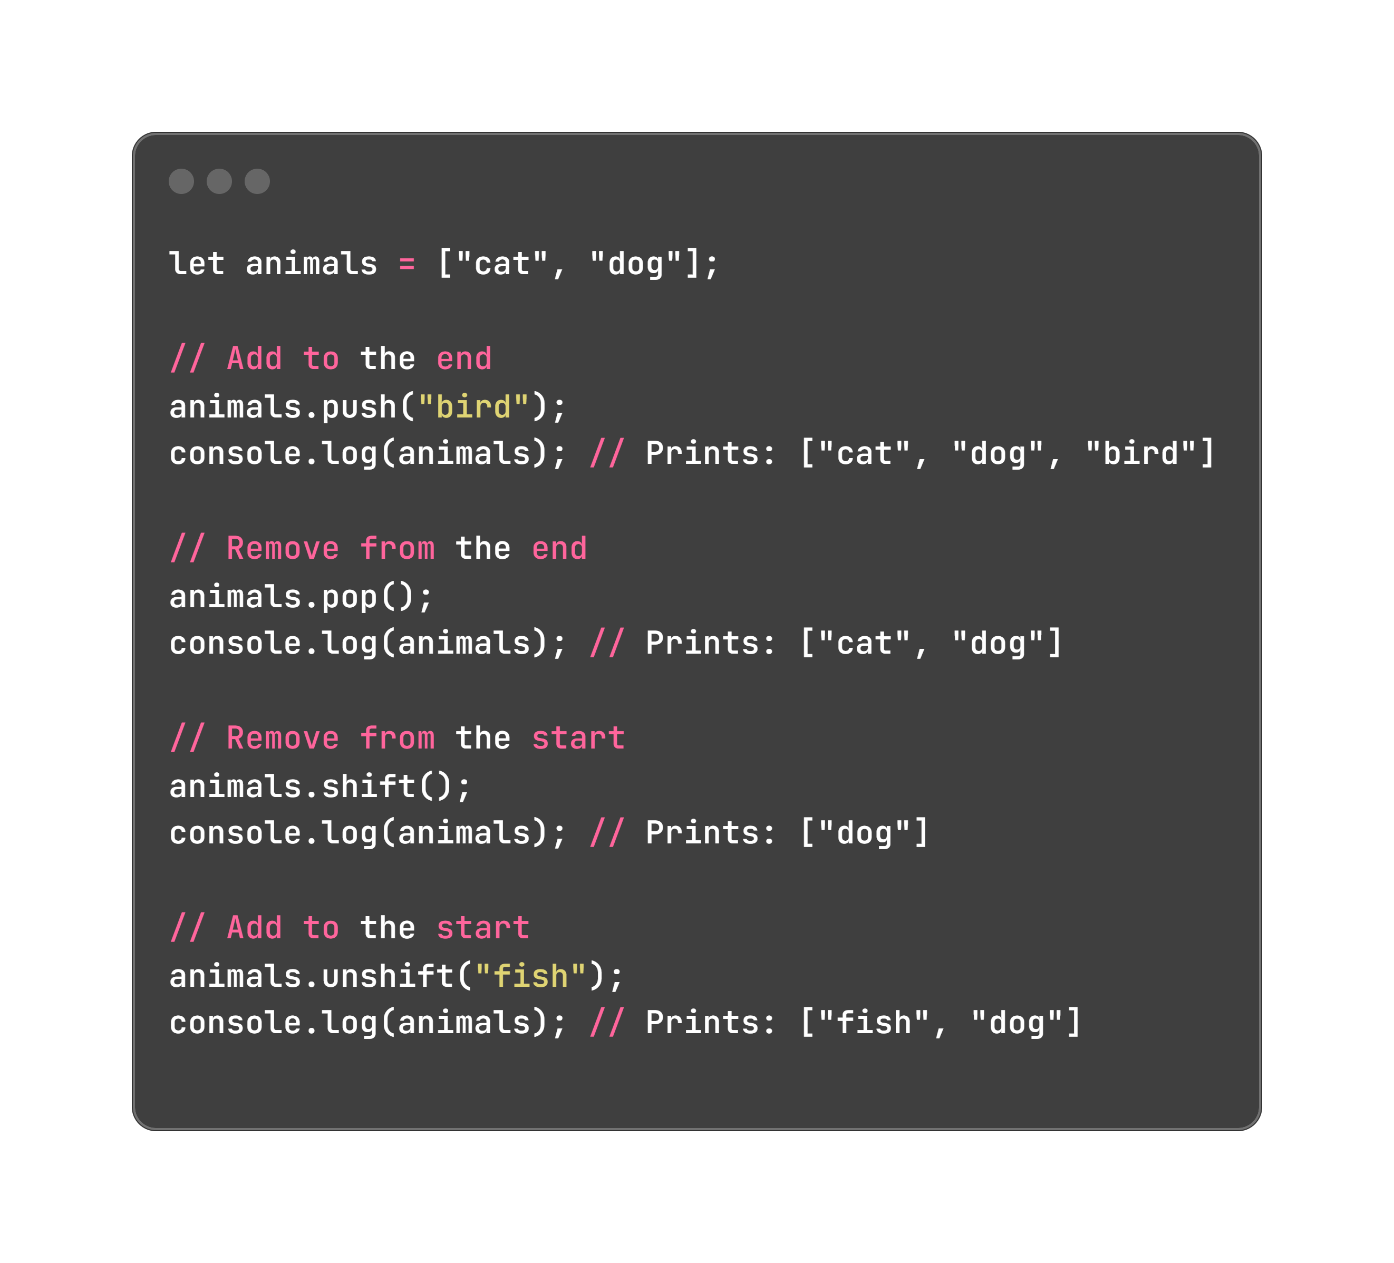
Example

Slide 22
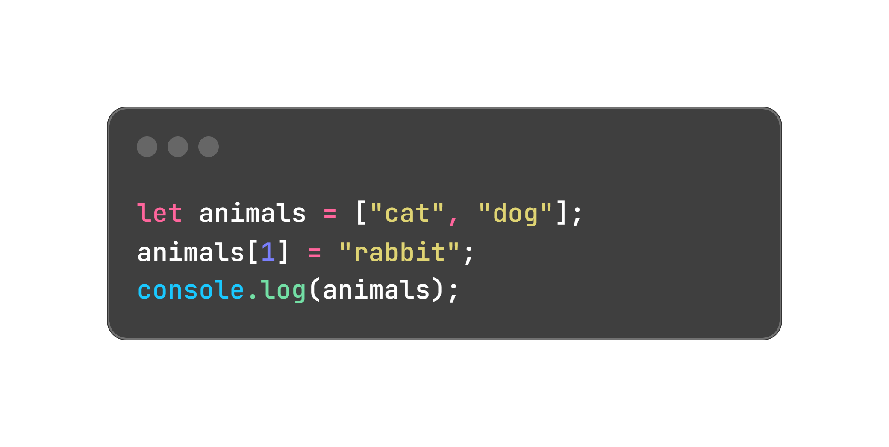
Update an Item:

Slide 23
Why Use These?
Add songs to a playlist (push).
Remove the last score in a game (pop).
Add a new user to the start of a list (unshift).

Slide 24
Tips:
pop and shift return the removed item (you can save it).
Be careful with shift and unshift—they move all items, which can be slow for big arrays.

Slide 25
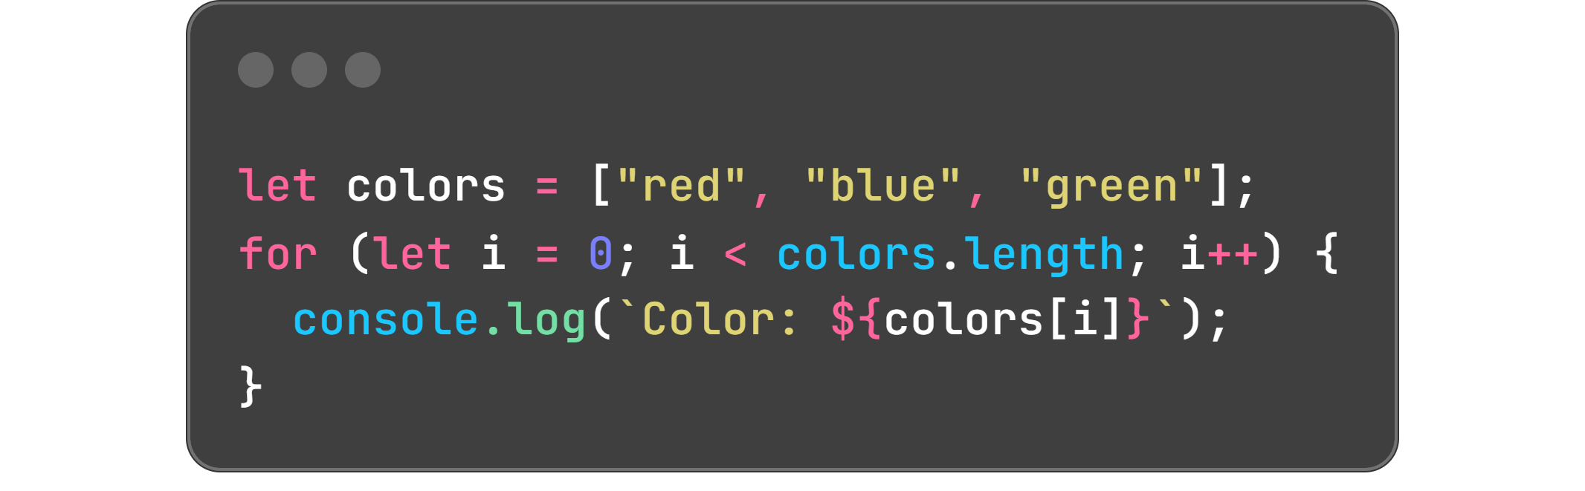
Looping Through Arrays
To check or show every item, like printing a grocery list.
Use for or while loops from Day 4.

Slide 26
Why Use These?
Show all items on a webpage.
Add up numbers in an array (like scores).
Find something in a list

Slide 27
Tips:
Use array.length to avoid going past the end.
Use clear index names like i or index.
Test with small arrays first.

Slide 28
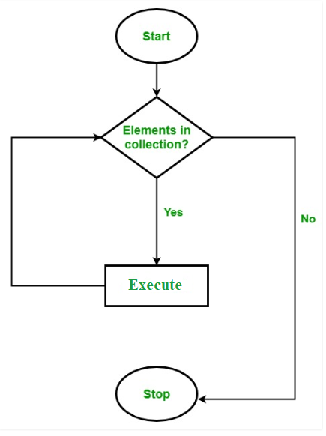
.forEach()
Loops through each item Doesn’t return anything

Slide 29
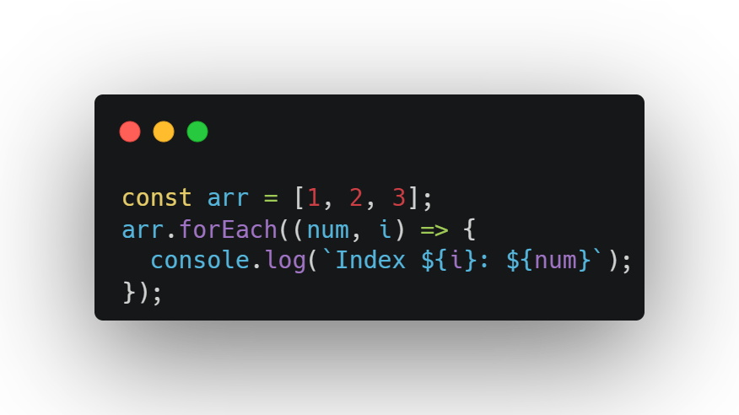
.forEach()
Loops through each item
Doesn’t return anything
Use it when: You just want to do something for each element (e.g., log it)

Slide 30
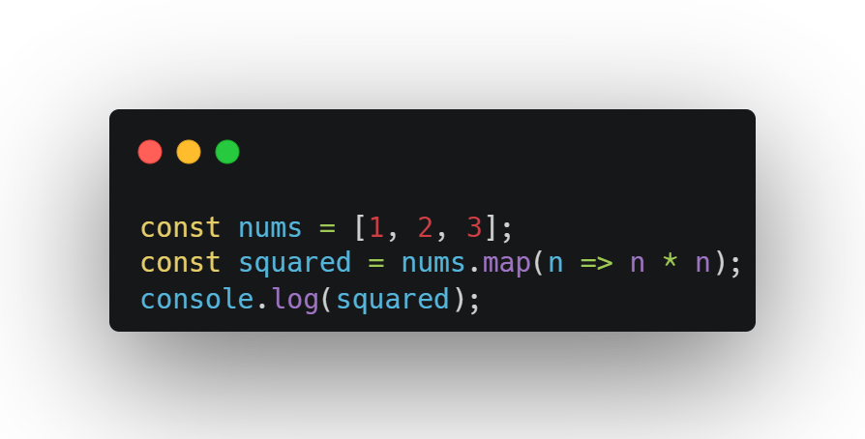
.map()
Transforms elements
Returns a new array Use it when: You want to change every item (e.g., double prices)

Slide 31
.filter()
Keeps items that pass the test
Returns a new array Use it when: You need only certain items (e.g., valid users)

Slide 32
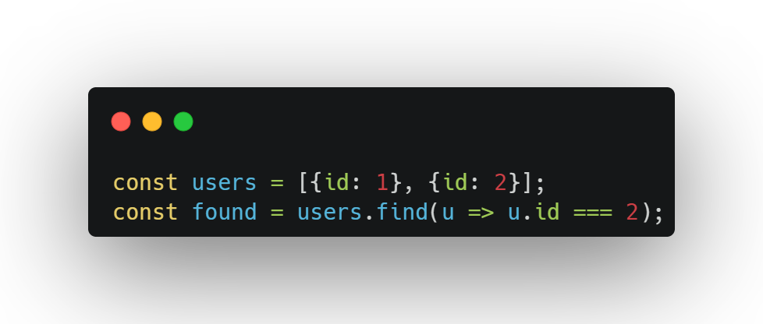
.find()
Returns first match
Returns only one item Use it when: You need to locate one object/value

Slide 33
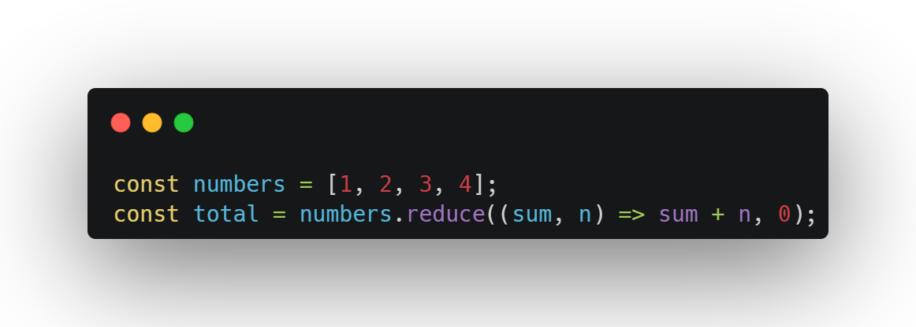
.reduce()
Combines all items into one value Use it when: You want a total, product, or single result

Slide 34
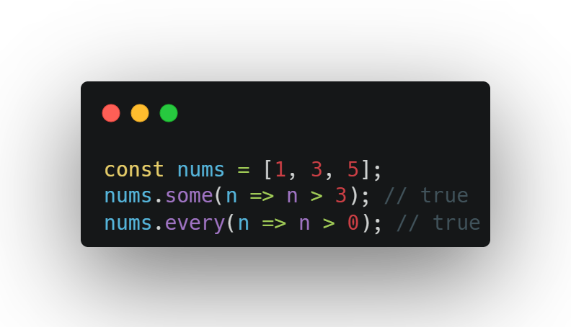
.some() and .every()
Returns boolean
Use it when: You’re checking conditions

Slide 35
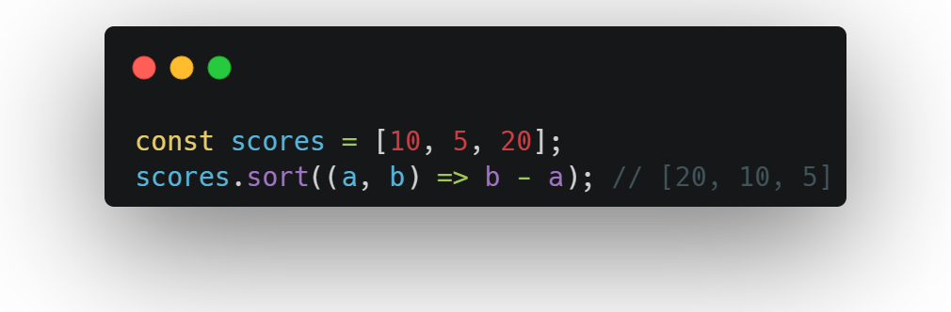
.sort()
Modifies original array
Use it when: You need ordering (ascending or descending)

Slide 36
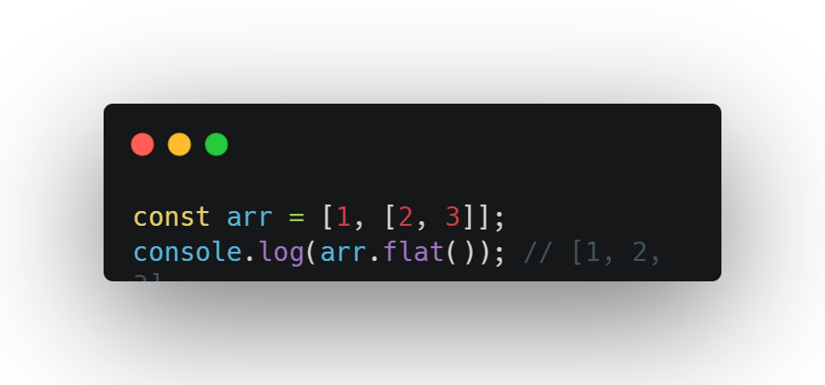
.flat()
Use it when: You want to flatten nested arrays

Slide 37
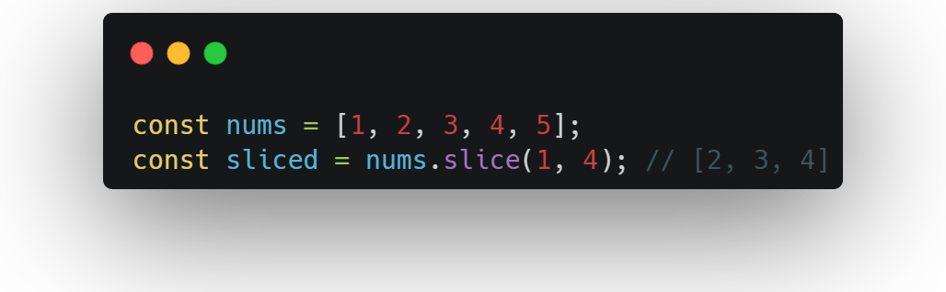
.slice()
Returns a shallow copy of part of an array
Does not modify original array Use it when: You need a portion of an array

Slide 38
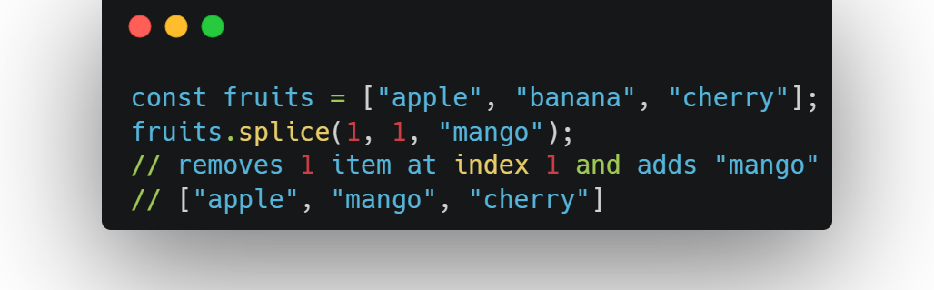
.splice()
Adds/removes items in original array
Modifies the array
Use it when: You want to add/delete/update items in-place

Slide 39
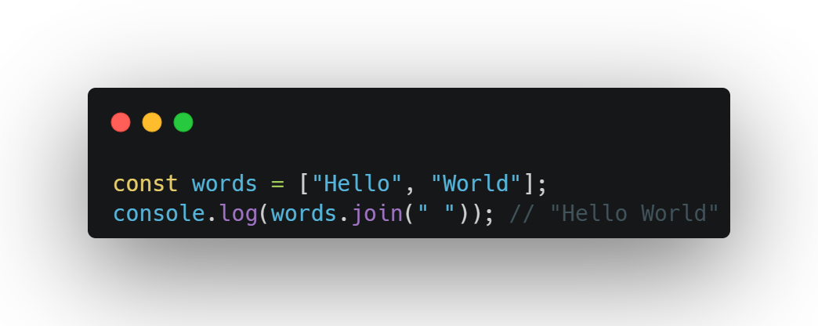
,join()
Converts array to string
You can specify a separator
Use it when: You need to create a sentence or CSV from an array

Slide 40
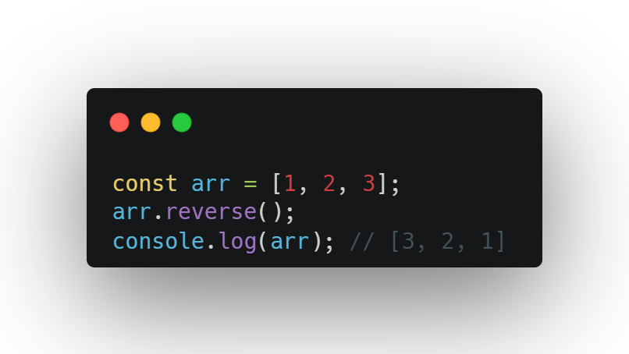
.reverse()
Reverses the original array
Modifies the array
Use it when: You want the last item to come first

Slide 41
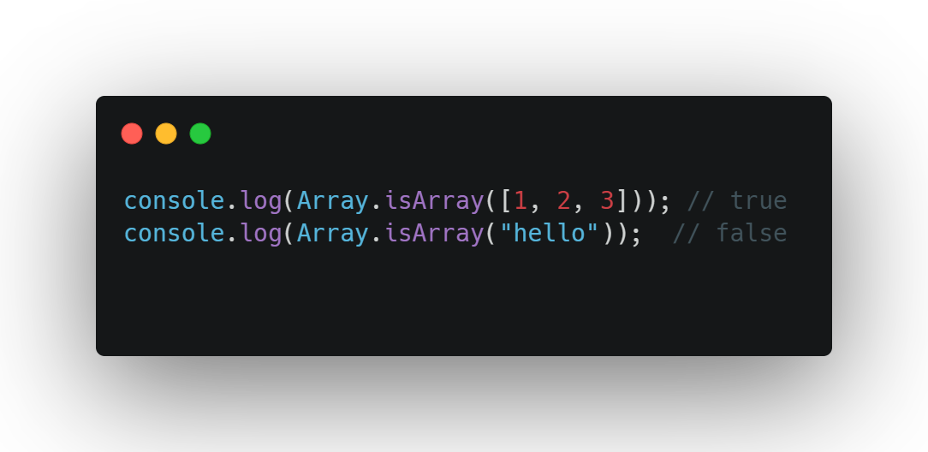
Array.isArray()
Checks if a value is an array
Use it when: You want to validate inputs before using array methods.

Slide 42
Question 1:
Double each number in [2, 4, 6] using map

Slide 43
Question 2:
Get numbers > 50 from [10, 60, 30, 80] using filter

Slide 44
Question 3:
Find sum of [5, 10, 15] using reduce

Slide 45
Question 4:
Check if all numbers in [1, 2, 3] are > 0 using every

Slide 46
Question 5:
Find the first even number in [1, 3, 4, 5] using find

Slide 47
Question 6:
Get [2, 3] from [1, 2, 3, 4] using slice

Slide 48
Question 7:
Replace "b" with "x" in ["a", "b", "c"] using splice

Slide 49
Question 8:
Turn ["Learn", "JS"] into "Learn-JS" using join

Slide 50
Question 9:
Reverse [1, 2, 3]

Slide 51
Question 10:
Check if 42 is an array

Slide 52
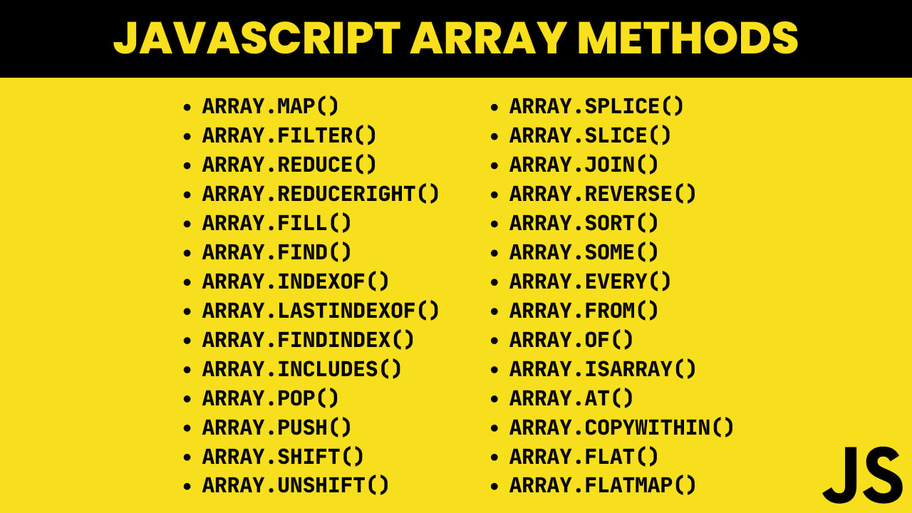

Slide 53
Exercise

Slide 54
Exercise 1: Grocery List
Goal: Create and show a grocery list.
Make an array with 3 grocery items.
Use a for loop to print each item.
Output: Item: milk, Item: bread, Item: eggs.

Slide 55
Exercise 2: Add and Remove Items
Goal: Add and remove items from an array.
Start with ["apple", "banana"].
Use push to add "orange".
Use pop to remove the last item.
Print the array: ["apple", "banana"].

Slide 56
Exercise 3: Update a list
Goal: Change an item in an array.
Start with ["cat", "dog", "bird"].
Change "dog" to "puppy".
Use a for loop to print: Animal: cat, Animal: puppy, Animal: bird.

Slide 57
Exercise 4: First and Last
Goal: Add and remove from the start.
Start with ["red", "blue"].
Use unshift to add "green" at the start.
Use shift to remove the first item.
Print: ["blue"].

Slide 58
Exercise 5: Count Items
Goal: Count specific items in an array.
Use ["apple", "banana", "apple", "orange"].
Use a for loop to count how many times "apple" appears.
Print: Found apple 2 times.

Slide 59
Bonus: Playlist App
Goal: Build a playlist app script.
Create an array with 3 song names.
Add a new song with push.
Remove the first song with shift.
Use a for loop to print the playlist with numbers (e.g., 1. Song Name).
Bonus: Add a song with unshift and print again.

Slide 60

What's the difference between pop() & shift()

Slide 61
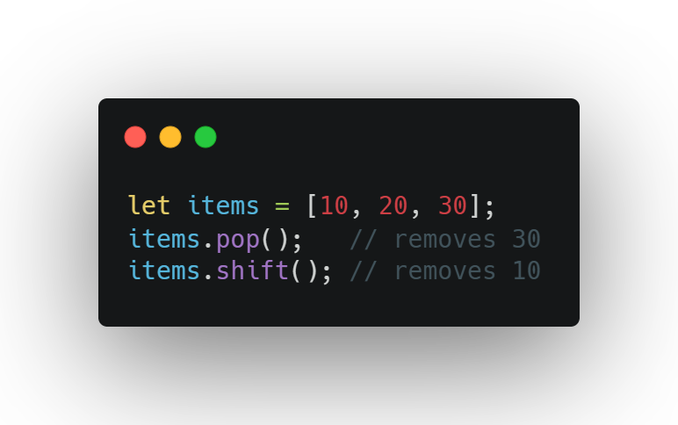
What's the difference between pop() & shift()
pop() removes the last item.
shift() removes the first item

Slide 62
What does indexOf() return ?

Slide 63
What does indexOf() return ?
indexOf() tells you where (at which index) a certain value appears in an array.
If the value is found, it returns the index number (starting from 0).
If the value is not found, it returns -1.

Slide 64
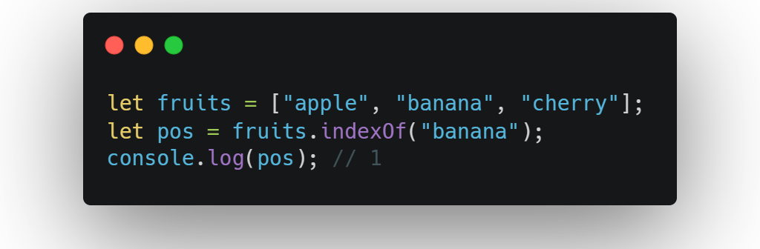
Example: Found in the Array
"banana" is at position 1 (0-based index), so that's what we get

Slide 65
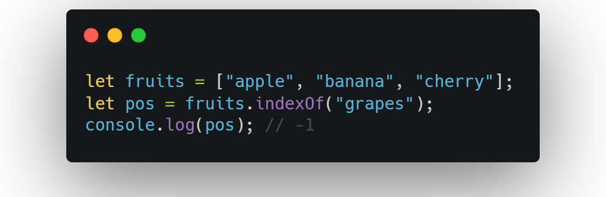
Example: Not Found in the Array
"grapes" doesn’t exist in the array — so indexOf() returns -1

Slide 66
What happened if I "delete" an Array item

Slide 67
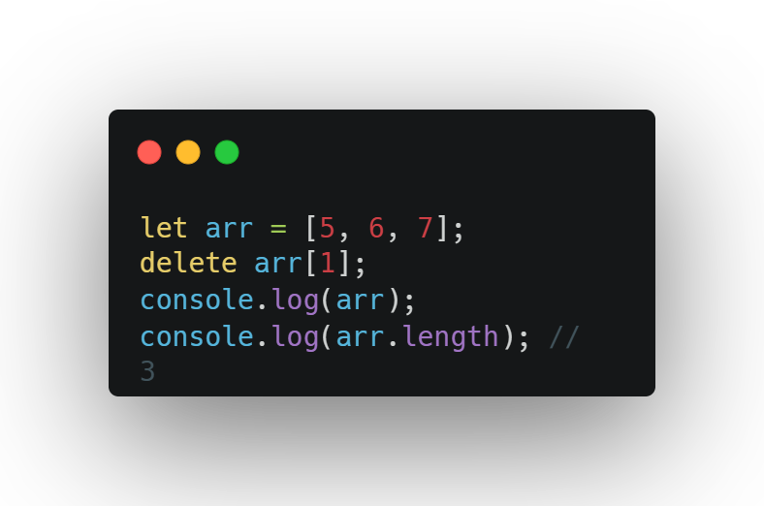
What happened if I "delete" an Array item
The item is removed, but the spot remains empty (undefined), and length stays the same.

Slide 68
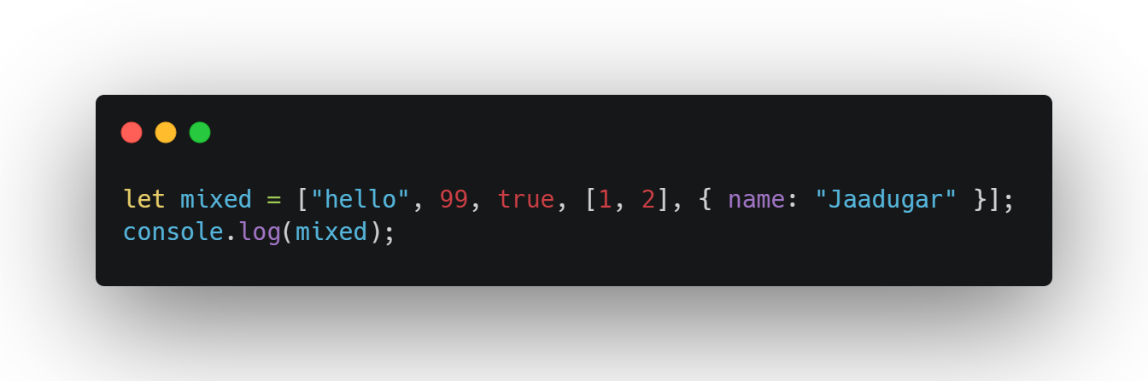
Can an Array hold different types
JavaScript arrays can hold mixed types—strings, numbers, booleans, even other arrays.

Slide 69
How to add something at the Start?

Slide 70
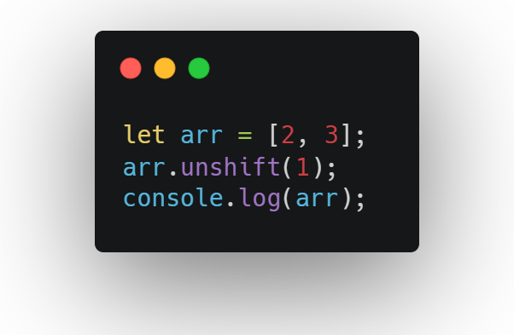
How to add something at the Start?
Use unshift() to add an item at the beginning of the array.

Slide 71


Slide 72

Recap...
Arrays: Lists to store items (like ["apple", "banana"]).
Indexing: Get items with array[0] (starts at 0).
Length: Use array.length to know how many items.
Methods: push, pop, shift, unshift to change arrays.
Looping: Use for or while to go through arrays.

Slide 73

Thank-You !!!

